Slide 1
Predict customer booking

Slide 2
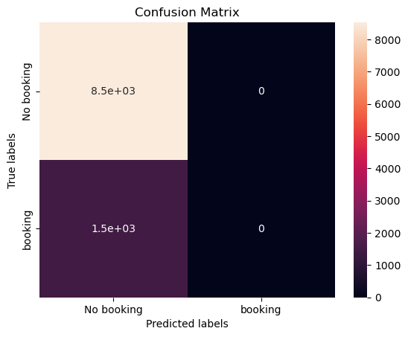
The model accurately predicted people who had not completed booking with an accuracy of up to 85%.
We can see that there is a huge gap between the data between completed and unfinished bookings, which affects the prediction. This shows we need to review and add the finished data.

